Slide 1

ESSENTIAL OILS
CHEM SEC 204TH
Department of Chemistry
Government College
Paonta Sahib (HP)

Slide 2
Topics
SANDALWOOD OIL (CHANDAN OIL)
EUCALYPTUS OIL
Chemical constituents
Sources
Uses

Slide 3
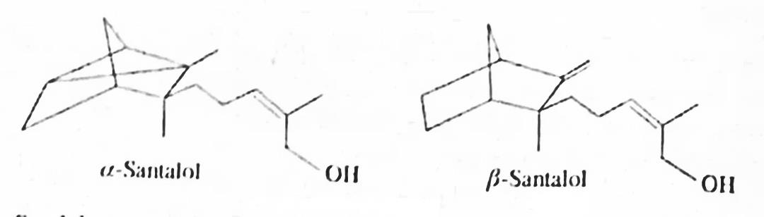
SANDALWOOD OIL (CHANDAN OIL)
It is an essential oil obtained from the steam distillation of chips and billets cut from heart wood of various species of sandalwood trees (Santalum album). It is also known as chandan oil, sandal oil or yellow sandalwood oil. It is said that older the tree, more quantity of sandalwood oil.
Chemical constituents:
Sandalwood contains mixture of two isomers α and β-santolol (90%), α- and β-Santalene, Santolone, Santanone, Isovaleraldehyde. α- and β-santalic acids etc, which imparts aroma to it.

Slide 4
Sources:
Sandalwood oil is obtained by distillation of dried wood from the plant Santalum album linn. These plants are available in India and Malaya. In India, trees are available in Tamil Nadu, Mysore, Maharashtra, Uttar Pradesh, Rajasthan, Gujarat etc.
Uses:
It is used in ayurvedic medicine for the treatment of both somatic and mental disorder, including common cold, fever and bronchitis.
It is used to treat urinary tract infections and inflammations.
Due to its coveted fragrance, the essential oil produced from sandalwood oil is often used in aromatherapy.
It is used in perfumes, cosmetics, sacred unguents etc.
It is also used as a mild food flavouring agent.

Slide 5
It is used to promote healthy and smooth skin.
It reduces the appearance of scars and blemishes.
It is used as mood enhancer.
It is frequently used in meditation for its grounding and uplifting properties.
It is commonly used in prayers throughout the world.
Sandalwood oil along with neem oil is used as a contraceptive.
Sandalwood oil along with double quantity of mustard oil is used for the treatment of pimples on the nose.
It drives away stress and anxiety.
It helps to keep blood pressure under control.

Slide 6
EUCALYPTUS OIL
These arc colourless or yellowish (aged sample) mobile liquids.
These are obtained by distillation of leaves of Eucalyptus. Eucalyptus oils in the trade are categorized into three broad types according to their composition and uses.
These are medicinal oils, perfumery oils and industrial oils. The most prevalent is the standard cineole-based-oil of eucalyptus, a colourless mobile liquid with penetrating comphoraceous, woody sweet scent.
China produces about 75% of eucalyptus oil. Other significant producers are South Africa, Portugal, Spain, Brazil, Australia, Chile and Switzerland.

Slide 7
Chemical composition: The principal component of eucalyptus oils I, 8 cinelole (eucalyptol) which comprises of 70% of the contents. All eucalyptus oils are composed in complex mixture 100 organic compounds Amos, more than It. different comixnmds. The main group of constituents of eucalyptus oil is monoterpenes. Other components of these oils are alcohols, aldehydes, aromatic hydrocarbons, phenols etc.
Sources: These oils are obtained by distillation of the leaves of Eucalyptus species. However, E. Koehii and E. polrbractea have highest cineole concentration.

Slide 8
Uses:
The cineole based oil is used as component in pharmaceutical preparations to relieve the symptoms of influenza, cold and cough.
These oils have anti-bacterial effects on pathogenic bacteria in the respiratory tract.
In low concentration, these oils are used in flavouring of various products like baked goods, confectionery, meat products and beverages.
These oils have anti-microbial activity against a broad range of food borne human pathogens and food spoilage microrganisms.

Slide 9
Eucalvptus, oil is also used as a fragrance component to impart a fresh and clean aroma in soaps, detergents, lotions and perfume.
Due to its cleansing properties, it is used in mouth rinses to freshen breathe.
Inhaled eucalyptus oil vapours are used as decongestant and treatment for bronchitis.
The main chemical components of eumlyptus oil are eucalyptol and alpha-terpineol. These
components have soothing and cooling vapours. It makes eucalyptus oil useful for massage.

Slide 10


